Slide 1
Virtual Welcome: Establishing Hospitality In Our Online And Virtual Church Community
A presentation by:
Rev. Cean James
Associate Conference Minister for Congregational Development
Pennsylvania Southeast Conference, United Church of Christ

Slide 2
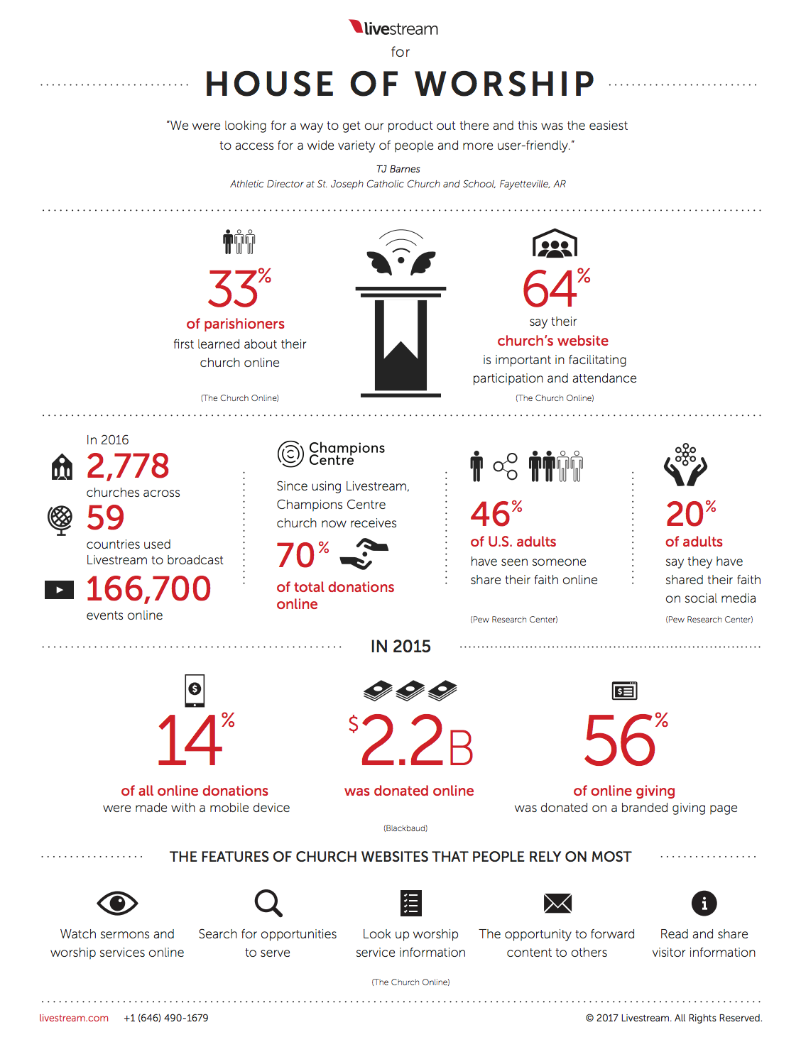
Necessity is the Mother of Invention
Christian worship in the United States, long characterized by its adherence to tradition, appears to have been significantly altered by the coronavirus pandemic.
Many congregations began to shift to some form of online worship before the pandemic, and those congregations were the most equipped to at the beginning of the pandemic.

Slide 3
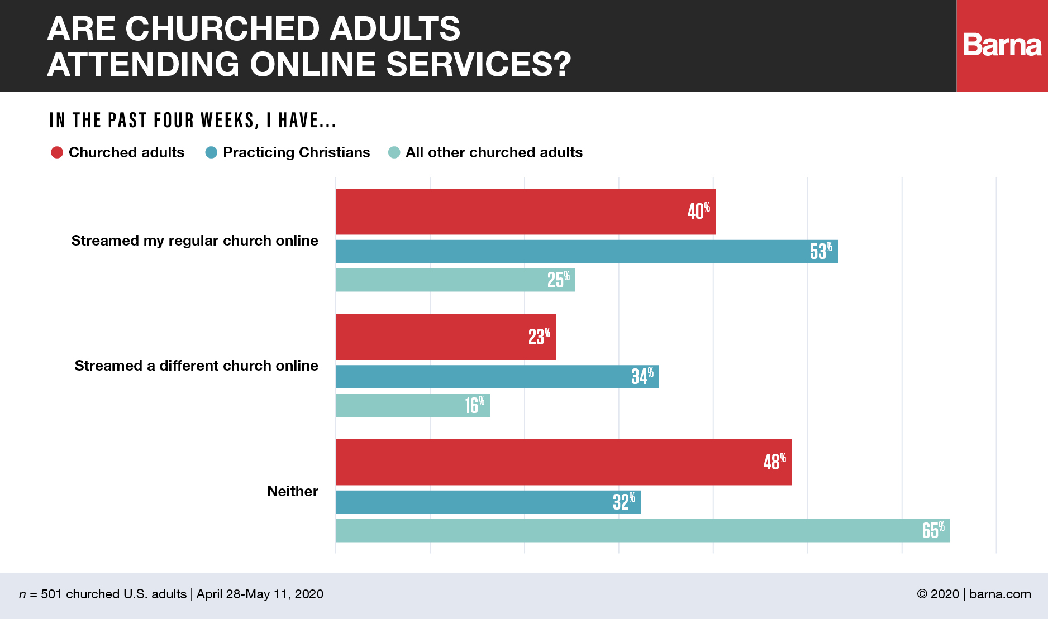
Necessity is the Mother of Invention
90% of congregations in the US report being closed to in-person worship at some point in 2020. With the pandemic still very much a reality, online worship has become the norm.
While online worship conformability does very based on age, even older generations are adapting.

Slide 4
Some of the benefits of virtual worship
Reach a Wider Audience
2. Easy and Convenient (once set up) 3. Affordable
4. Keep people Engaged 5. Boost Participation
6. Save All Your Important Moments
7. Welcome Potential Visitors

Slide 5
PSEC Pandemic Worship Survey
9 out of 10 churches are holding some sort of virtual service.
The most popular formats for sharing virtual services are Facebook, YouTube, and Zoom (in that order).
62.2% are using Facebook
52.7% are using YouTube
33.8% are using Zoom
Other methods include: emailing services (27%), mailing DVDs or CDs (7.1%), phone service for “Dial-a-Sermon”, GotoMeeting, Twitter, LinkedIn, or through their websites.
Most people reported a slight increase in attendance from regular services 47% of the churches are not meeting in-person at all yet
Many of the churches returned to in-person over the past summer, only to return then to online as the pandemic raged.

Slide 6
What Are We Missing?
About a month ago I visited as many online worship services from our conference as I could in an afternoon after church while watching football. I saw a lot that was truly remarkable. There was, however, one thing that I noticed was missing.
I then went back a watched about a month of my own services and noticed that the same hole was there also.
Just to make sure, I hoped on a few services of churches from around the country, same thing. The missing ingredient was:
Hospitality

Slide 7
Growing Churches Value Welcome
The one ingredient that all churches have in common, regardless of demographics, theology, denomination, geography, polity, size, etc., is welcome!

Slide 8
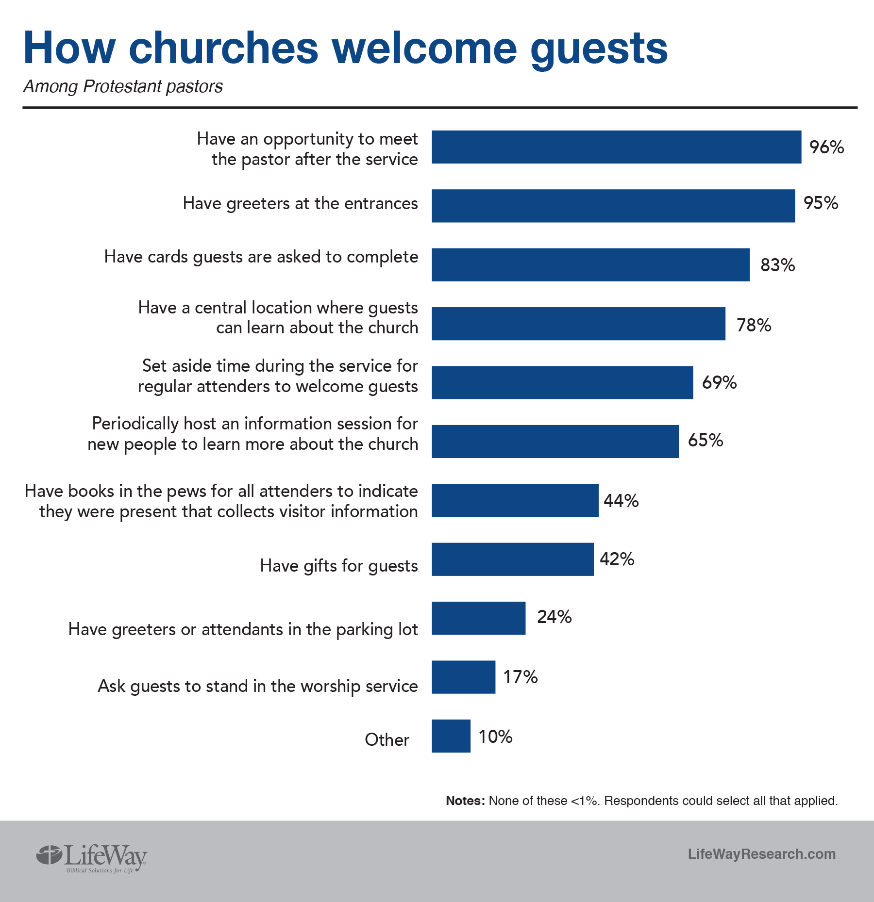
Give Yourself Some Grace
Most of us value welcome in person and we are really good at doing it.
Passing the Peace
Greeters and Ushers
Building Signage
Follow-up
Welcome Packet
Coffee Hour
Inclusive Language
Screens with Instructions

Slide 9
Online Hospitality
1. Have A Specific Time in Your Worship for Welcome
Just as you would in-person, take a moment to recognize those who are visiting as a part of the worship service.
If you use title screens, identify this as a separate section of the worship service.
This welcome should come from the pastor or worship leader, looking directly into the camera.
Open this space up for visitors and people who are already connected, but you want to emphasis those who are new.
https://twelvethirty.media/church-online/welcome-scripts-for-online-church/
Ask people to identify as new or a visitor to your service.

Slide 10
Online Hospitality
2. Designate a group of Online Greeters
At the church building, we often would assign people the task of greeting – being near the entrance and saying hello to everyone, being available to guide newcomers and answer any questions they might have.
Have a preassigned (and trained) group of members who will be present online to greet anyone who new. You probably already have some people who are great in the chat and very engaged during worship; use them!
This will be done primarily in the chat. Could be a breakout room on Zoom.
Good Morning [insert name], my name is Joy and I want to welcome you to worship this morning. We are so excited that you decided to join us. Please click this link for your official welcome message: http://bit.ly/SnLWelcome

Slide 11
Online Hospitality
3. Video, Forms, and Follow Up
Every church member should feel empowered to welcome people to worship. The greeting team will just make sure that its done and visitors have someone specific to connect to and ask questions.
The online greeters should leave a follow-up message with visitors at the end of worship. Thank you for joining us, please come again. You can contact me if you have any questions.
The greeters can also direct visitors to fill out a form that will allow you get information about them and gauge how involved they are prepared to become.
http://bit.ly/SnLWelcome

Slide 12
Online Hospitality
3. Congregational Care
You have probably noticed that worshipers are leaving pastoral care concerns and prayer requests in the chat during your worship services. These should not go unaddressed.
Using either the online greeters, or a separate group (deacons, clergy who are not preaching) have someone available to respond appropriately to pastoral care concerns that are left in the chat or shared verbally (on Zoom, etc.)
Remember that we are not having the usual before/after church conversations where concerns are brought to the leadership, but the concerns are very present. There should be an initial response and appropriate follow-up

Slide 13
Online Hospitality
4. Follow Up
Even during times of in-person worship, the aspect of hospitality that is most often missed is follow up. Churches tend to have a wide-open back door. Intentionality is needed to “close the back door
Almost 90% of guests will return to visit a second time if someone follows up with them on the same day of that first visit.
Use every available means of technology to follow up with visitors (and members who have become “inactive”). Call, text, DM, social media.
The sooner you follow up the better.

Slide 14
Online Hospitality
5. Develop Your Online Service with Guest in Mind
Likewise, this is as important during in-person worship, but even more so online.
Visitors do not know the inside language of Christianity in general or your church specifically. You should never assume that everyone know anything. Explain often and speak in a manner that avoids “insider” and “outside” feelings.
Church members feel much more comfortable inviting friends and family to online service than in-person service.

