Slide 1
Articulating Call
Call: What is it?
A theology of call?
Call and how it relates to the Church and its ministry
Call and Call cycle

Slide 2
What is Call
Assumes a caller
An elusive thing to describe
“An invitation to wholeness”—Marjory Bankson
“The sound of the genuine”---Howard Thurman

Slide 3
A Theology of Call
“All Christians are ordained into a life, both personal and corporate, that carries the power of Jesus Christ for the sake of the world.”
Christians are “ministers” by virtue of their baptism, called to exercise faithful presence in the world

Slide 4
A Theology of Call
“The gifts he gave were that some would be apostles, some prophets, some evangelists, some pastors and teachers, to equip the saints for the work of ministry, for building up the body of Christ, until all of us come to the unity of the faith and of the knowledge of the Son of God, to maturity, to the measure of the full stature of Christ” --Ephesians 4:11-13

Slide 5
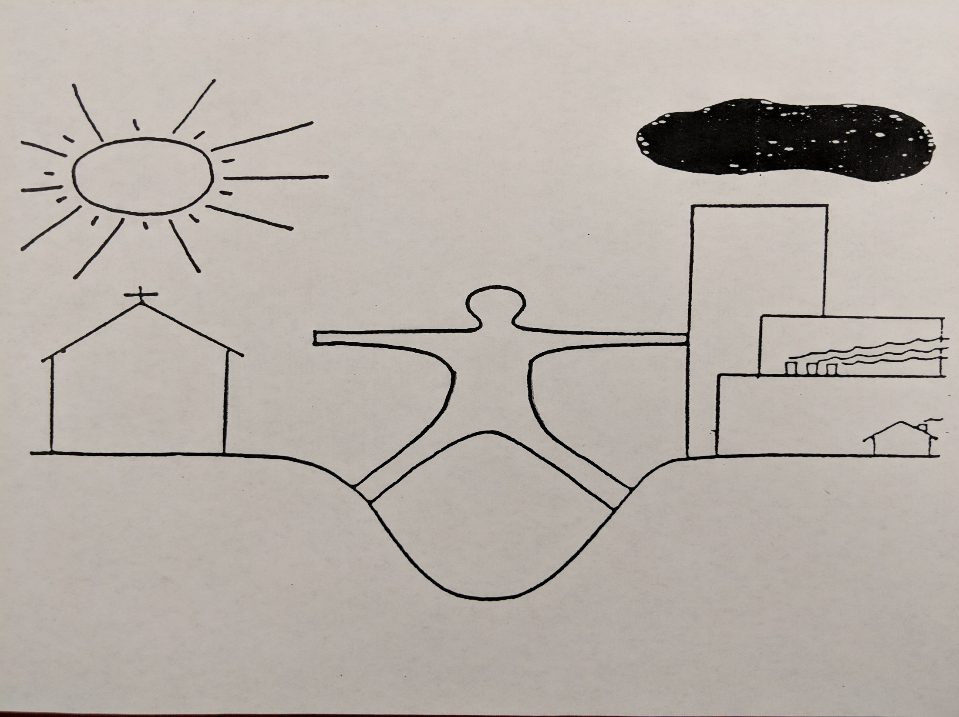

Slide 6
A Theology of Call
To what degree does the ministry of the church focus on helping all Christians discover, claim and articulate their call as well as equip, support and hold them accountable for their life of faithful presence in the world?
To what degree is ministry about maintaining an institution (I support my church) at the expense of followers of Jesus exercising leadership on the mission field (as a member of the body of Christ)?

Slide 7
“The Purpose of the Church and its Ministry”---H. Richard Niebuhr
The call to be a Christian, a call to discipleship, grounded in one’s baptism
The secret call, the inner experience one has as summoned to serve God in a particular way
The providential call that comes through talents, gifts, direction to fulfill that ministry
The ecclesiastical or church call extended by a part or the entire community or institution

Slide 8
Ordained Ministry
“Called by God and ordained to preach and teach the gospel, to administer the sacraments and rites of the church, and to exercise pastoral care and leadership”
Constitution and By-laws of the United Church of Christ (Preamble and Article V, paragraph 20)
To what end? To what end do we preach and teach the gospel, administer sacraments, exercise pastoral care and leadership?

Slide 9
Pastoral Authority: Based on H. Richard Niebuhr
From where is pastoral authority derived?
The church, a communal authority
From scripture, (Psalm 1; Jeremiah 15:16-17)
From personal, spiritual, and moral authority

Slide 10
Pastoral Authority: Based on H. Richard Niebuhr
To whom are you called to serve?
The church is not separate from society, not to be an ark in the midst of a flood
The church is a community of faith to be nurtured and equipped

Slide 11
Some Questions
To what degree am I called to care for others, and to what degree am I called to equip and empower others for their ministry?
To what degree am I called to administer the church as institution and organization, and to what degree am I called to lead the church in mission as a movement in the world?

Slide 12
Articulating Call: Parker Palmer
“Vocation does not come from willfulness. It comes from listening. I must listen to my life and try to understand what it is truly about---quite apart from what I would like it to be about---That insight is hidden in the word vocation itself, which means a calling that I hear.”

Slide 13
Vocation and Call: Parker Palmer
Vocation does not mean a goal I pursue. It means a calling that I hear. Before I can tell my life what I want to do with it, I must listen to my life telling who I am. I must listen for the truths and values at the heart of my own identity.” ------ Parker Palmer
From: Let Your Life Speak

Slide 14
Call and Call Cycle: Marjory Z. Bankson,” The Call to the Soul”
Queen Esther: Persia
Resist: Mordecai asks Esther to intervene to reverse edict to destroy Jews but she wants to hide her Jewish identity
Reclaim: Mordecai reminds Esther of her identity “If not you, God will send someone”
Revelation: “Perhaps you’re here for such a time as this”

Slide 15
Call and Call Cycle: Marjory Z. Bankson, “The Call to the Soul”
(The Poison River) Esther sends word for Jews to fast and pray and she does as well. She takes off her robes, symbols of power
Risk: Esther risks going into the king. She then offers to make dinner for the king and Haman, the chief perpetrator of Jewish oppression
Relate: Esther realizes the time is not right to make a request of the king to remove the edict of death to Jews.

Slide 16
Call and Call Cycle: Marjory Z. Bankson, “The Call to the Soul”
Relate: Haman builds gallows for Mordecai. The king honors Mordecai, thus putting fear into Haman. At the next dinner the king promises Esther whatever she asks. Esther asks for her life and for the life of her people. Esther calls upon the king again to allow Jews to defend themselves. The balance of power shifts
Release: Esther’s work is done

Slide 17
Call Conversation
What is currently calling you? What is it about your call that as of now energizes you, attracts you, and connects with you?
What’s important to you? What values aspirations, and guiding principles are you bringing with you around this call?
What are you worried for concerned about?
What soul signals are you getting?

